Slide 1
The Gateway Alliance
The history and evolution of the Gateway Alliance for Compassionate Care at End-of- Life and the efforts to advocate for end-of-life issues in St. Louis area.

Slide 2

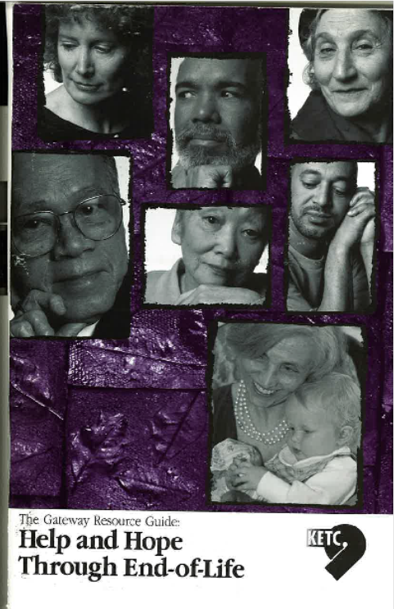
Gateway End-of-Life Coalition began in April 2000.

Slide 3
Gateway End-of-Life Coalition dissolved in 2006.

Slide 4
In 2007 the Gateway Alliance for Compassionate Health Care was revitalized.
Missouri End-of-Life Coalition Saint Louis Chapter

Slide 5
DARE TO MAKE A CHANGe
Our Goals:
Improve the care and quality of living for persons at the end of life in the Greater St. Louis Metropolitan area.
Educate the public, health care providers, students, and policy makers regarding optimal care, resources, and policy for the maximum benefit of dying persons in the greater Saint Louis Metropolitan area.
To promote collaboration between health care providers, community educators, and organizations.
Empower dying persons, loved ones, and caregivers to express their needs and expectations surrounding end-of-life issues.

Slide 6

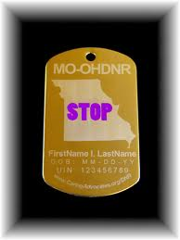
Desire to further education and advocacy for end-of-life issues
2008-Present: National Healthcare Decisions Day (NHDD)-April 16
2009-Out of Hospital DNR (OHDNR)

Slide 7
the mission of the Gateway Alliance is to promote high quality EOL care for patients and their families.
TODAY…
Our Goals:
Educate the public, health care providers and students, regarding optimal care for the maximum benefit of persons at EOL.
Promote collaboration among health care providers, patients, family members, educators, and organizations that provide or promote EOL care.
Advocate for quality EOL care with policy makers.

Slide 8

www.gatewayeol.com

